Slide 1
Global Happiness Prediction
Ian Johnson, Hayden Dessommes, Ethan Kaiserman

Slide 2
Our Data
Our dataset contains different predictors to determine a country's overall happiness rating for their average citizen

Slide 3
Features
GDP per capita
Social support
Healthy life expectancy
Freedom to make life choices
Generosity
Perceptions of corruption

Slide 4
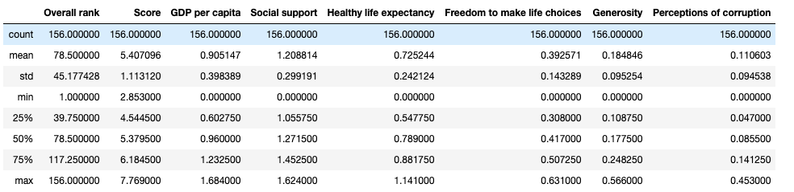
Summary Statistics
fgdfgdfgdf
Happiness score seems to be centered around 5.4, with majority of countries/regions being within 4-6

Slide 5
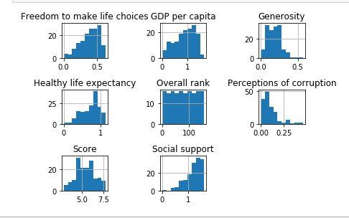
Distribution of Features

Slide 6
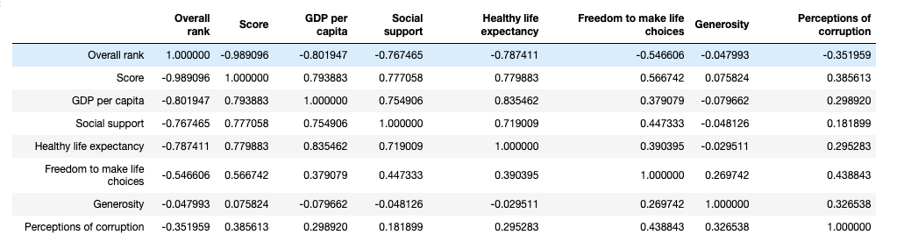
Correlation Matrix
By looking at the correlation matrix, we determined that GDP per capita, Social support, and Healthy life expectancy had the highest correlation with overall score.

Slide 7
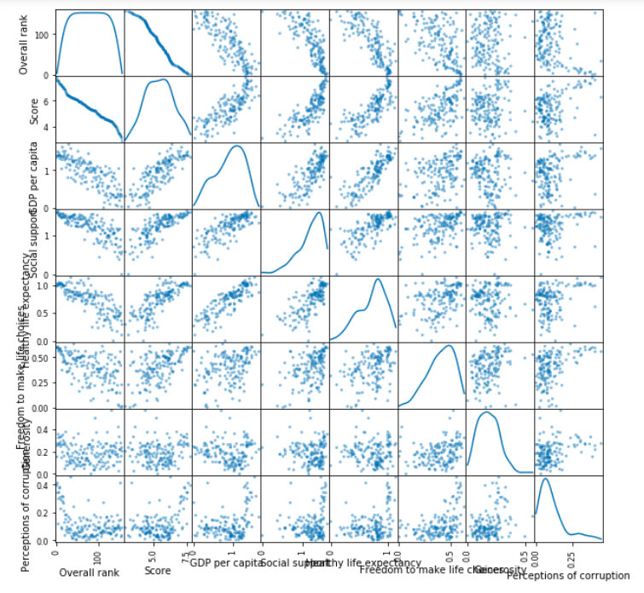
Correlation Matrix Scatter Plot

Slide 8
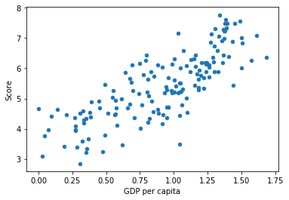
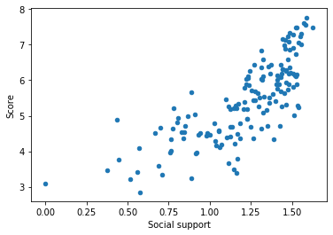
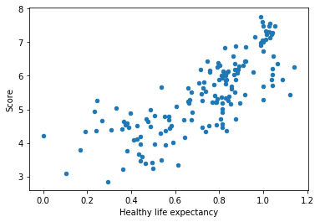
Scatterplots of Highest Correlated Features

Slide 9
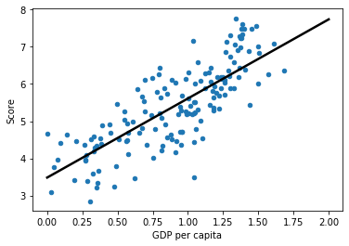
Linear Regression
Used an 80/20 split for the training/testing set
Used GDP per capita to predict score, since it had highest correlation with score
Obtained an r-squared value of .73

Slide 10

Multiple Linear Regression Model with 3 features
Added social support and health expectancy to try and get better results
Obtained a r-squared value of .75

Slide 11

Multiple Linear Regression Model with all Features
Used all 6 features to predict Overall score
Obtained an R-squared value of .76
Best performing linear regression model

Slide 12
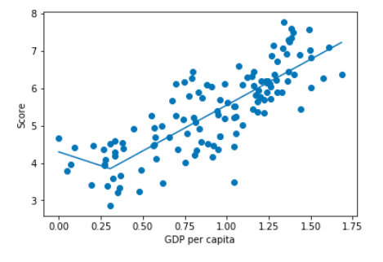
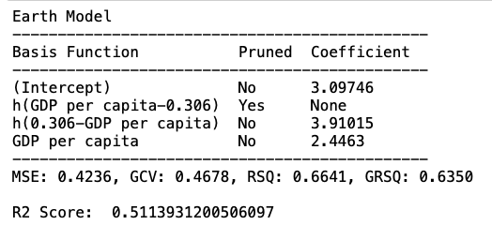
MARS (Multivariate Adaptive Regression Splines)
Like Multiple Linear Regression, but line has “hinge”
On the right is MARS with 1 feature
Notice the hinge at x = .306

Slide 13
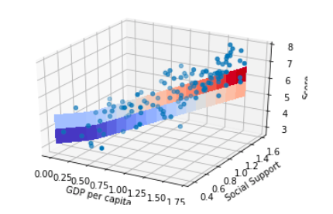
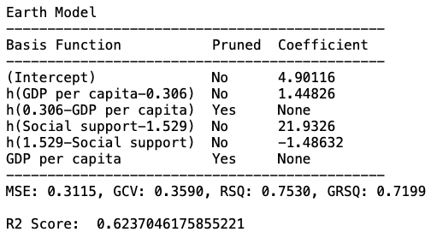
MARS with 2 Features
Notice the “hinges” in the 3D graph
Does better with 2 features

Slide 14
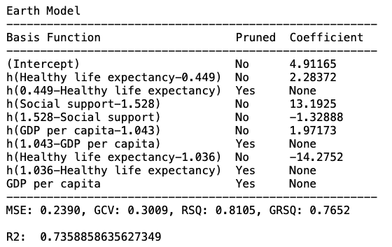
MARS with 3 Features
Better than 2

Slide 15
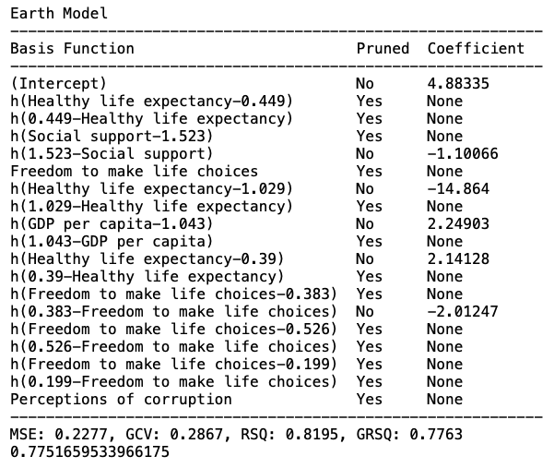
MARS with All Features but Generosity
Generosity has least correlation
Does it outperform MARS with all features?

Slide 16
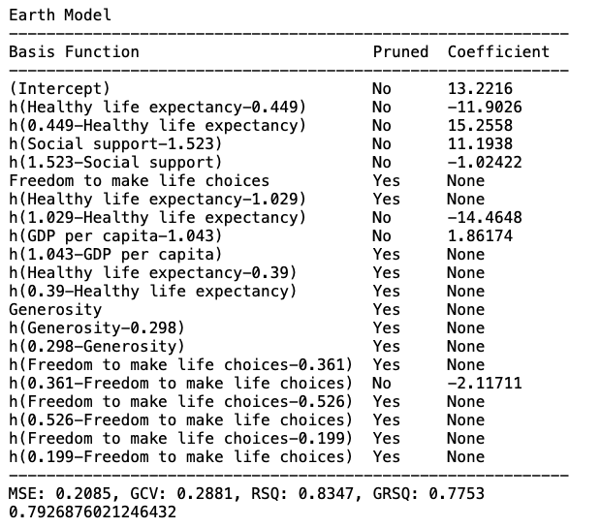
MARS with All Features
Performs the best
Not surprising since all features were somewhat correlated.

Slide 17
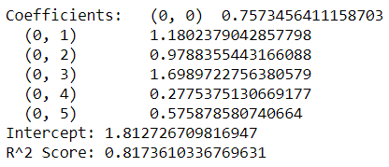
Lasso with .001 Alpha
Coefficient 0: GDP per capita
Coefficient 1: Social support
Coefficient 2: Healthy life expectancy
Coefficient 3: Freedom to make life choices
Coefficient 4: Generosity
Coefficient 5: Perceptions of corruption
Highest R^2 Value
All coefficients are included in the model

Slide 18
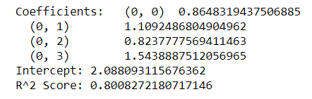
Lasso with .01 Alpha
Coefficient 0: GDP per capita
Coefficient 1: Social support
Coefficient 2: Healthy life expectancy
Coefficient 3: Freedom to make life choices
Coefficient 4: Generosity
Coefficient 5: Perceptions of corruption
2nd highest R^2 Value
The last two coefficients have been removed from the model compared to the previous Alpha.

Slide 19

Lasso with .1 Alpha
Coefficient 0: GDP per capita
Coefficient 1: Social support
Coefficient 2: Healthy life expectancy
Coefficient 3: Freedom to make life choices
Coefficient 4: Generosity
Coefficient 5: Perceptions of corruption
3rd highest R^2 Value
Only the first two coefficients remain
We can reasonably assume that the first few variables are weighed more in predicting Happiness compared to the last few.

Slide 20

Lasso with .5 Alpha
Coefficient 0: GDP per capita
Coefficient 1: Social support
Coefficient 2: Healthy life expectancy
Coefficient 3: Freedom to make life choices
Coefficient 4: Generosity
Coefficient 5: Perceptions of corruption
Lowest R^2 Value
No coefficients remain
Any value with r^2 value higher than .5 will also have zero as value for each coefficient

